Slide 1
Delhi's average AQI (Air Quality Index) today is varying between 370 to 430, making breathing extremely difficult. The massive amount of pollutants in the air is causing an unfortunately huge number of diseases of various types within the people living in and around Delhi. Even the air inside homes and other enclosed areas is of very poor quality. To breathe freely in indoor spaces, devise a method which can measure the AQI of the space and switch on the mechanisms which can lead to purification of the air inside the premises. (Only detection software and alarm is needed)
Problem Statement
Tarran Sidhaarth - 21BBS0069
Purvesh Sohony - 21BBS0016
Ananya - 21BBS0273
Shrihari Kulkarni - 21BBS0084

Slide 2

Idea
To increase the safety of the residents by offering a cheap & easy solution to cleaner and breathable air in our homes.
Using a simple arduino based sensor which is integrated with Alexa.
The sensor detects poor quality air and gets Alexa to announce and turn the air purifier on.

Slide 3


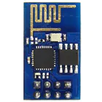
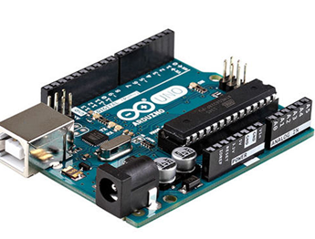


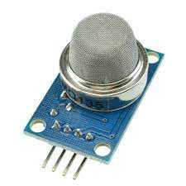
Materials used
Arduino Controller
ESP8266
Jumper Wires (Male to Female)
Temporary Power Supply
Board
MQ 135

Slide 4
Working
The MQ-135 sensor detects the gases in the air and once the AQI passes a threshold,
The arduino sends a signal to the ESP8266 which sends a signal to Alexa announcing “AQI has passed safety value, switching on the air purifier” and
Then proceeds to switch on the air purifier.
Note: The device can be switched off when not in use for long periods

Slide 5
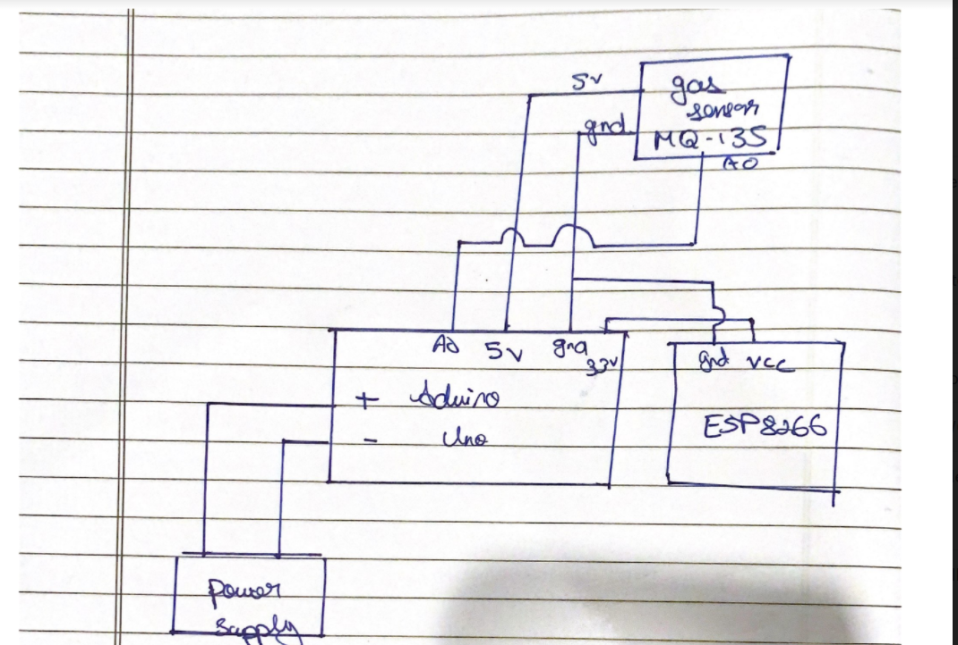

Draft Circuit Diagram
Note :
This is a prototype circuit diagram, it can be improved.

Slide 6


Inspiration & References
We were inspired to make an affordable and easy solution to cleaner and breathable air in our homes using the following concepts:
Alexa Based Smart Home Monitoring
MQ-135 Gas Sensor For Air Quality

